Slide 1

Linux Intro

Slide 2

Linux
Unix-like operating system distributed free of charge under the GNU License
Available in several “distributions” to serve different purposes. (bundles of included software)
Originally written by Linus Torvalds. Now almost 10,000 developers including major technology companies like Intel and IBM.

Slide 3

Where is Linux used?
Majority of internet servers run Linux
67% of the world’s web-servers run Linux (2016)
Used in Research/High-Performance Computing
Google, Amazon, NSA, 100% of TOP500 Super-computers
Mobile devices
Android phones
Amazon Kindle
IoT devices
Smart TV, Roku box, etc

Slide 4
Why Linux?
Numerous Cybersecurity tools for Linux
Majority of tools are free!
Linux allows you complete control of the system
Puts user in driver’s seat, trusts you know what you want
Linux can be made more secure
Open Source code means it is free to explore, review, modify, secure, copy/reuse
Linux is entirely customizable You can shut down processes that might be a security risk
Windows and Mac have processes you cannot disable

Slide 5
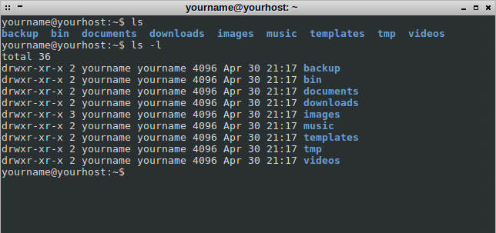
Linux Command Line
Interface to the underlying operating system
Built-in commands
Environment variables
Programming control structures
Linux supports different shells (interfaces)
Most common is perhaps bash
Also sh, zsh, csh, ksh, etc.

Slide 6
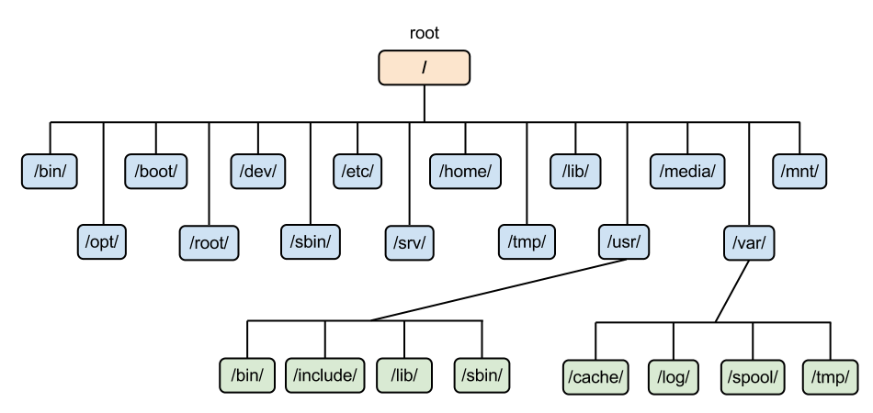
Linux: The Filesystem
The structure resembles an upside-down tree
Directories (a.k.a. folders) are collections of files and other directories.
Every directory has a parent except for the root directory.
Many directories have subdirectories.

Slide 7
Linux Command Line Prompt
Username
Current Directory
~ is shorthand for your home directory
[username@hostname ~]$
System Name
Input

Slide 8
Linux Commands & Arguments
[username@hostname ~]$ command --option argument
Command - program that does one thing
Argument - provides the input/output the command uses

Slide 9
Linux Commands
ls |  | List files in current directory
ls -al |  | List files in current directory show all files and display details in long format
cd directory |  | Change Directory followed target name (cd with no target will go back to “home” directory)
cd .. |  | Go “up” one directory
mkdir name |  | Make Directory followed by new directory name
rmdir name |  | Remove Directory, followed by target name
cat file |  | Print contents of file to screen (literally “concatenate” file’s contents to screen)
CTRL+C |  | Will typically stop or exit most any command

Slide 10
Linux Commands
pwd |  | Print working directory (full name of current directory)
whoami |  | Print current username (if not already shown)
date |  | Print system time and date
cal |  | Print simple calendar
wc file |  | Print number of lines, words, and letters in file
mv file dest |  | Move file to destination (or new filename)
cp file dest |  | Copy file to destination (or new filename)
rm file |  | Remove file
man command |  | View manual (more info) about command (Q to Quit)

Slide 11
Linux Commands
hostname |  | Name of computer
uname -a |  | System details (kernel information)
cat /proc/cpuinfo |  | Print information about CPU
cat /proc/meminfo |  | Print information about RAM
tree |  | Show “tree-like structure of current directory and subdirectories. (CTRL+C to quit)

Slide 12
Linux Commands
more file |  | Print contents of file one screen-full at a time Press SPACE to see next screen-full
less file |  | Just like more (“less is more”) but allows arrow keys to scroll up and down (Q to Quit)
head file |  | Print first 10 lines of file
head –n 2 file |  | Print only first 2 lines of file
tail file |  | Print last 10 lines of file
tail –n 6 file |  | Print only last 6 lines of file
sort file |  | Sort the contents of file and print to screen
diff file1 file2 |  | Highlight differences between file1 and file2
grep term file |  | Find keyword term in file, print lines that match

Slide 13
Linux Text Editors
nano |  | Simple word command line editor
emacs |  | Customizable editor Support for all most programming languages
vi |  | Lightweight, powerful editor POSIX-standard (included on all Unix systems) Steep learning curve
sed |  | Simple “stream editor” for command line file edits Most experienced users will simply use a text editor Useful for automating an edit process

Slide 14
Linux Networking Tools
ifconfig |  | Network interface configuration tool Used to determine IP address, MAC address and state of network link
ping addr |  | Tool used to test latency in a network connection to address addr (IP address or hostname)
traceroute addr |  | Print the route packets take to address addr
nslookup domain |  | Query DNS server for information about domain
dig domain |  | In-depth query of DNS server about domain
dig domain ANY |  | Return all DNS information about domain (including mail, aliases, and other IPs)

Slide 15
Do one thing well
Most Linux commands only do one thing, but they do that one thing in many ways.
String commands together using the ‘pipe’ operator: |
Search for term “failed” in log file then “pipe” the output into the sort command for sorted output:
grep failed login-attempts.log | sort
Show tree structure of home directory but display using ‘less’ to allow scrolling up and down (Q to Quit)
tree /home | less

Slide 16
sudo
To perform some actions reserved for a system administrator, you must have ability to act as the root user.
The command sudo instructs a command to do the command as the “super user” (aka root)

Slide 17
Try this: cd mkdir example ls –al
Who owns the folder “example” you just created?
Delete that folder.
Try this: sudo mkdir example ls –al
Who owns that folder? Now try to delete it…
Notes:
To remove an empty folder owned by root: sudo rmdir example

Slide 18
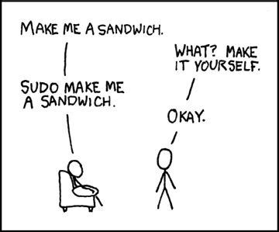
sudo

